Slide 1
Decision-Centric Virtual Metrology for Geometric Deviation via Foundation-Embedding Retrieval
Danny Hoang¹, Ryan Matthiessen², Christopher Miller², Nasir Mannan², Ruby ElKharboutly, PhD³ David Gorsich, PhD⁴, Matthew P. Castanier, PhD⁴ , and Farhad Imani, PhD¹
¹University of Connecticut, Storrs, Connecticut, USA
²Connecticut Center for Advanced Technology, East Hartford, Connecticut, USA
³Quinnipiac University, Hamden, Connecticut, USA
⁴US Army DEVCOM GVSC, Warren, Michigan, USA

Slide 2
Contents
Background & Motivation
Model
Experiment Design & Results
Conclusion

Slide 3
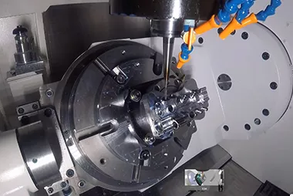

Background
Advanced manufacturing for aerospace and defense increasingly depends on the ability to produce complex, high-value components with exceptional geometric precision.
Recent studies in precision machining [1,2] and aerospace assembly [3,4] continue to show that geometric and spatial errors remain major barriers when tight tolerances must be sustained across complex tool paths and multi-stage processes.
Image: elimold.com
[1] D. Hoang, R. Chen, G. Bollas, and F. Imani, “Hyperdimensional computing for explainable information fusion and multi-task adaptation in advanced manufacturing,” Information Fusion, p. 103898, 2025.
[2] S. He and T. Shi, “Sensitivity analysis of surface contour error to geometric errors for four-axis ultra-precision machine tools,” Journal of Manufacturing Processes, vol. 131, pp. 569–588, 2024.
[3] R. Yang, J. Huang, Z. Chen, D. Lian, S. Gao, X.-C. Zhong, J. Li, Y. Liu, and J. Tan, “Measurement and optimization method for aero-engine rotors based on binocular multi-line laser sensing and virtual assembly,” Measurement, vol. 242, p. 115808, 2025.
[4] F. Guo, Y. Zhang, C. Song, and X. Sha, “Identification and precise optimization of key assembly error links for complex aviation components driven by mechanism and data fusion model,” Advanced Engineering Informatics, vol. 64, p. 103059, 2025.
Image: www.wmwcnc.com

Slide 4
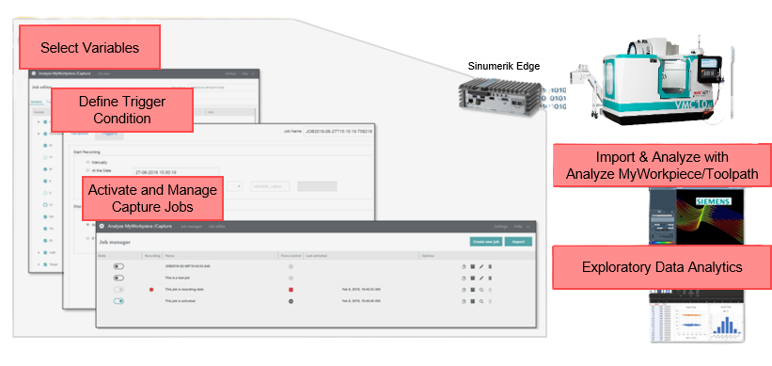
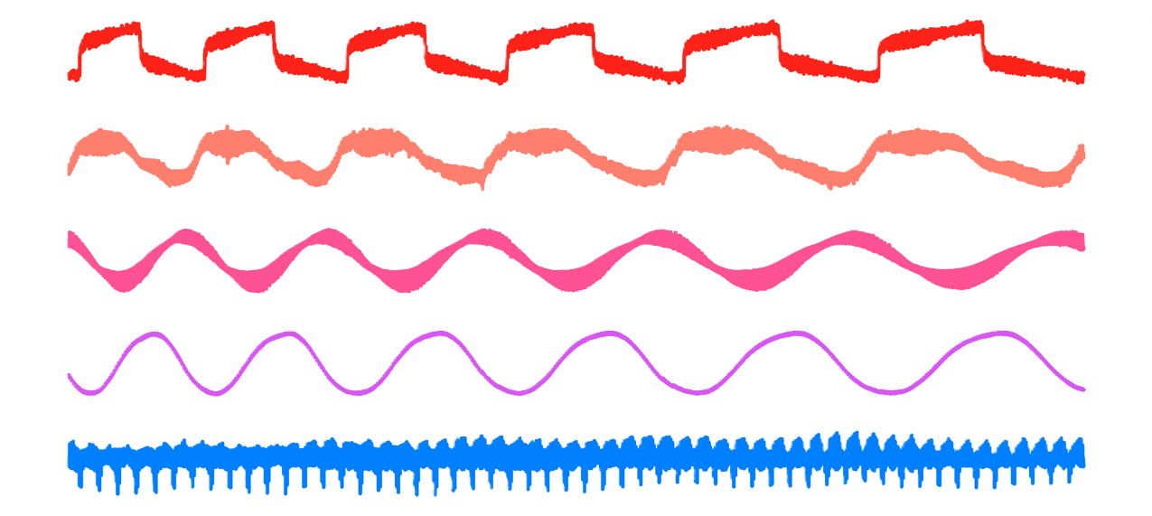
Background
High-frequency multichannel process signals can be collected directly from machine controllers, yet reliable geometric quality labels from metrology remain expensive and delayed [5,6].
Conventional supervised approaches such as decision trees, and neural networks learn relationships between process signals and quality outcomes but often require repeated retraining to remain effective as manufacturing conditions evolve [7,8].
Timeseries Signals
[5] E. Stathatos, E. Tzimas, P. Benardos, and G.-C. Vosniakos, “Convolutional neural networks for raw signal classification in cnc turning process monitoring,” Sensors, vol. 24, no. 5, p. 1390, 2024.[6] S. He and T. Shi, “Sensitivity analysis of surface contour error to geometric errors for four-axis ultra-precision machine tools,” Journal of Manufacturing Processes, vol. 131, pp. 569–588, 2024.
[6] Q. Zhuang, N. Wan, Y. Guo, G. Zhu, and D. Qian, “A state-of-the-art review on the research and application of on-machine measurement with a touch-trigger probe,” Measurement, vol. 224, p. 113923, 2024.
[7] A. K. Kausik, A. B. Rashid, R. F. Baki, and M. M. J. Maktum, “Machine learning algorithms for manufacturing quality assurance: A systematic review of performance metrics and applications,” Array, vol. 26, p. 100393, 2025
[8] C. Kubik, J. Hofmann, D. A. Molitor, M. Becker, and P. Groche, “Reliable machine learning models for manufacturing processes,” The International Journal of Advanced Manufacturing Technology, vol. 138, no. 11, pp. 5913–5927, 2025

Slide 5
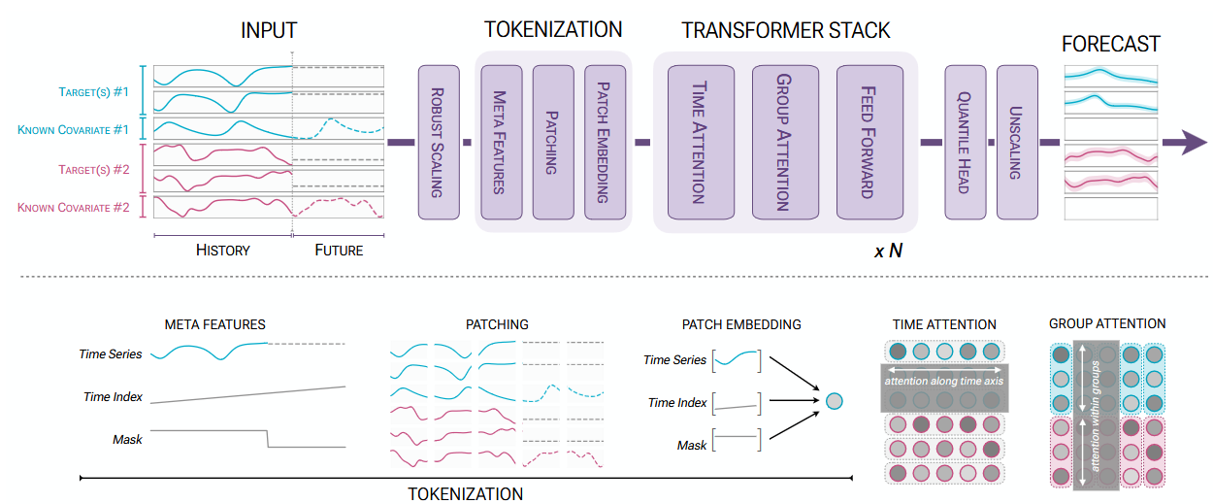
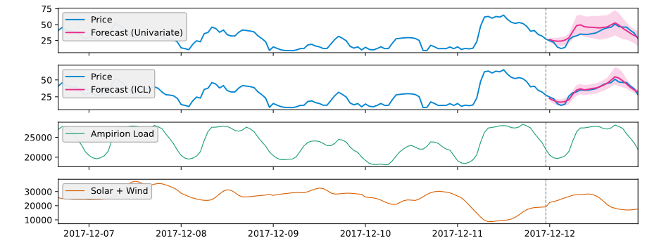
Background
Time series foundation models provide a promising alternative as they separate large-scale pretraining from downstream task adaptation.
Chronos demonstrated strong zero-shot and transfer performance across diverse forecasting benchmarks, while Chronos-2 extends this capability to univariate, multivariate, and covariate-informed settings, making it more suitable for industrial sensor streams [9,10].
Image: [10]
Image: [10]
[9] A. F. Ansari, L. Stella, C. Turkmen, X. Zhang, P. Mercado, H. Shen, O. Shchur, S. S. Rangapuram, S. P. Arango, S. Kapoor et al., “Chronos: Learning the language of time series,” arXiv preprint arXiv:2403.07815, 2024.
[10] A. F. Ansari, O. Shchur, J. K¨uken, A. Auer, B. Han, P. Mercado, S. S. Rangapuram, H. Shen, L. Stella, X. Zhang et al., “Chronos-2: From univariate to universal forecasting,” arXiv preprint arXiv:2510.15821,2025.

Slide 6
Motivation
Advanced manufacturing requires tight tolerances and exceptional accuracy for complex aerospace and defense parts.
At the same time, manufacturing environments are data rich but label-poor especially for multi-channel process signals.
Time series foundation models allow analysis of multivariate signals for downstream applications with limited retraining.
Solution: We proposes ChronosGD, a retrieval-based framework for geometric deviation prediction that combines frozen Chronos-2 embeddings with similarity search over historical process windows.

Slide 7
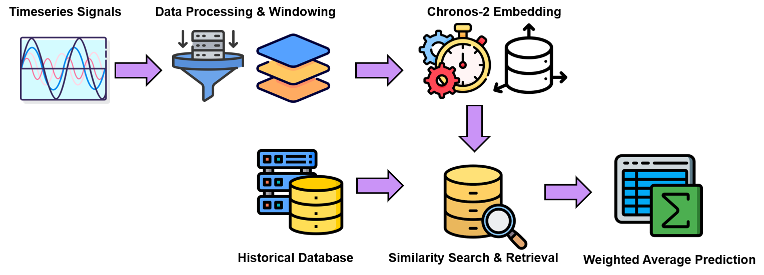
ChronosGD: Model Overview

Slide 8
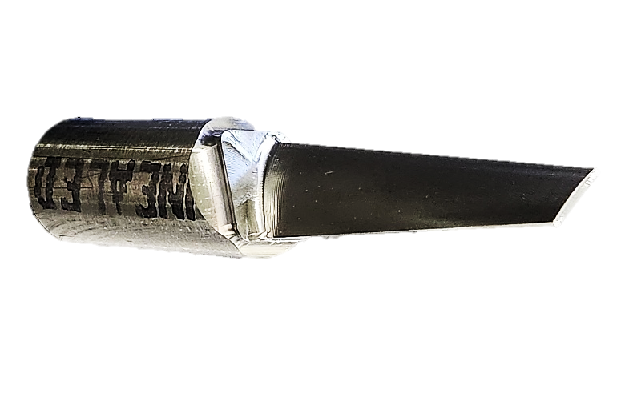

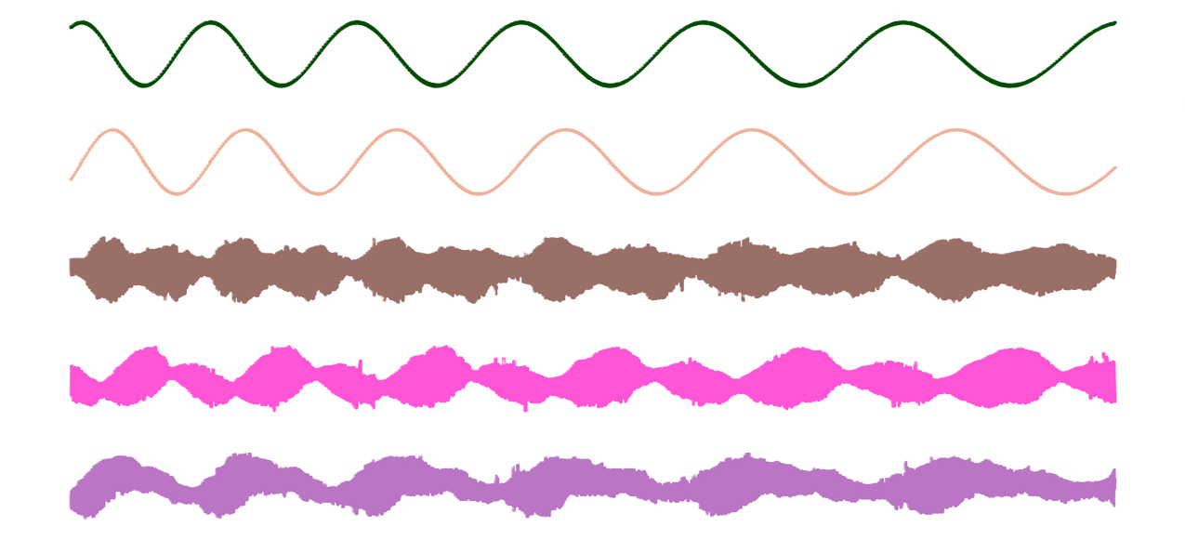
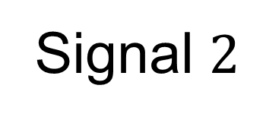

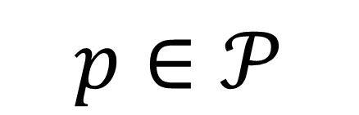
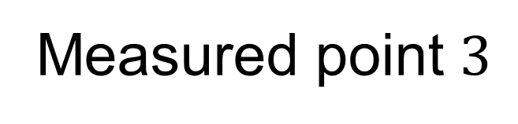
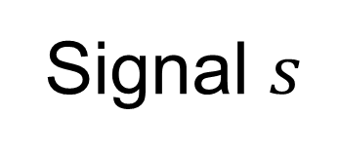



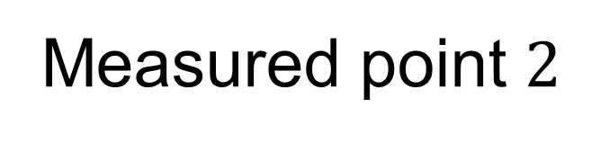
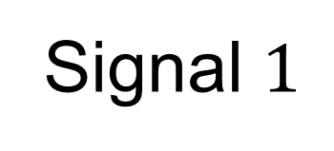
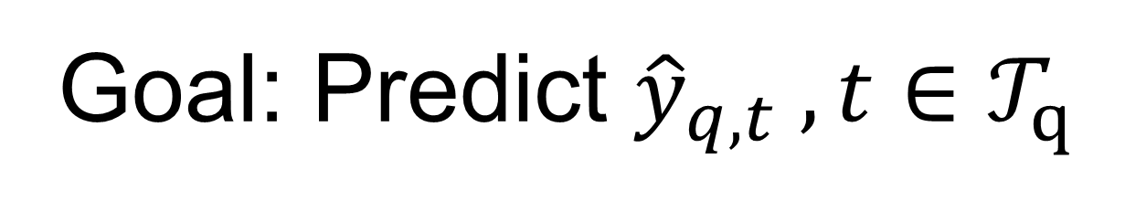

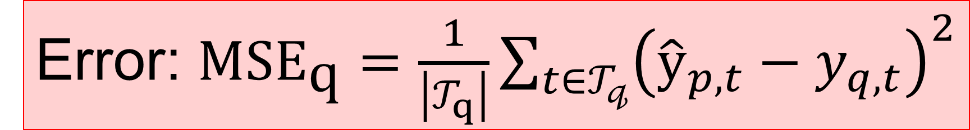
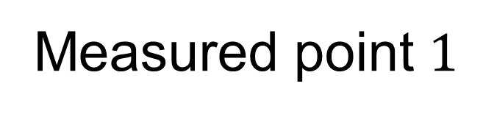
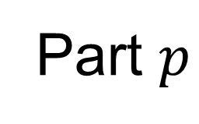
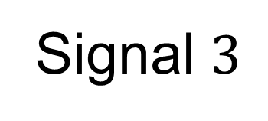

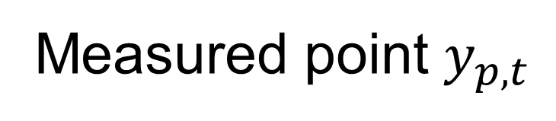
Model: Problem Formation
$p$ $∈𝒫$
$t$ $∈𝒯_{p}$
Part $p$
Inspection point $1$
Part 1
Part 2
Inspection point $2$
…
Inspection point $3$
…
Signal $1$
Inspection point $t$
Signal $2$
…
Measured point $1$
Signal $3$
Measured point $2$
…
Measured point $3$
…
Signal $s$
Measured point $y_{p,t}$
$s$ $∈𝒮_{p}$
Goal: Predict ${\hat{y}}_{q,t} ,t∈𝒯_{q}$
Error: $\text{MS}{\text{E}}_{\text{q}}=\frac{1}{\left|𝒯_{q}\right|}\sum_{t∈𝒯_{𝓆}}{{\left({\hat{y}}_{p,t}−y_{q,t}\right)}^{2}}$

Slide 9

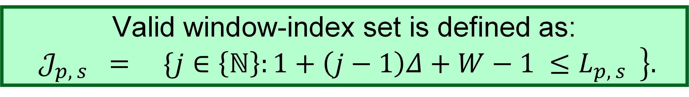
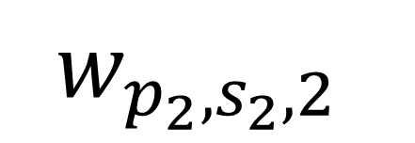

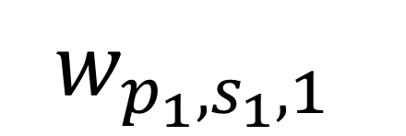

Model: Historical Memory Construction
For each historical part $p ∈𝒫∖\{q\}$and signal $s ∈ S$, sliding windows of length $W$and stride $Δ$ are extracted from the corresponding signal.
$$Δ$$
$$w_{p_{1},s_{1},1}$$
$$W$$
$$w_{p_{2},s_{2},2}$$
$$L$$
Valid window-index set is defined as:
$$𝒥_{p, s} = \left.\{j∈\left\{ℕ\right\}:1+\left(j−1\right)Δ+W−1 ≤L_{p, s} \right\}.$$
For each $j∈𝒥_{p, s}$, let $τ_{j}=1+\left(j−1\right)Δ$ and define the corresponding signal window as:
$$w_{p,s,j}=x_{p,s}\left[τ_{j}:τ_{j}+W−1\right]∈ℝ^{𝕎}.$$

Slide 10
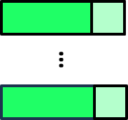
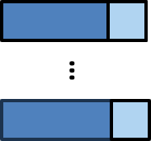

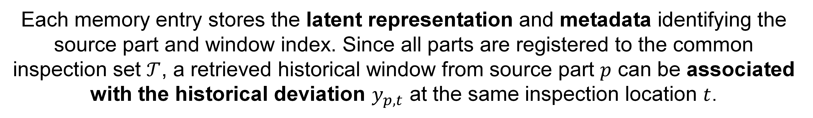

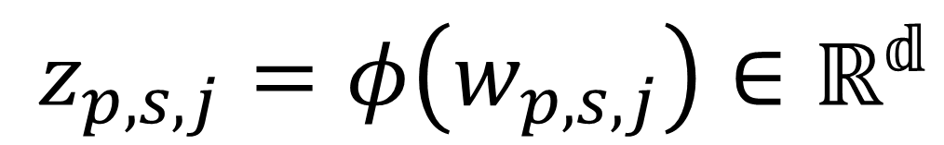
Model: Historical Memory Construction
$$w_{p_{1},s_{1},j}$$
Latent Space
$z_{p,s,j}=φ\left(w_{p,s,j}\right)∈ℝ^{𝕕}$
For each signal $s$, the historical retrieval memory excluding the query part is defined as the set of tuples:
$$ℐ_{s}^{\left(−q\right)}=\left\{\left(z_{p,s,j},p,j\right):p∈𝒫∖\{q\},;j∈𝒥_{𝓅,𝓈}\right\}$$
Each memory entry stores the latent representation and metadata identifying the source part and window index. Since all parts are registered to the common inspection set $𝒯$, a retrieved historical window from source part $p$ can be associated with the historical deviation $y_{p,t}$ at the same inspection location $t$.

Slide 11


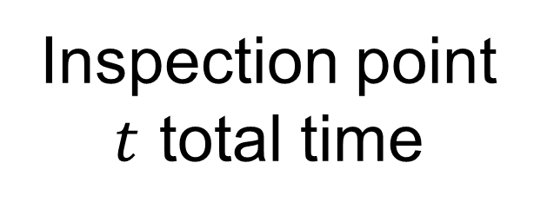
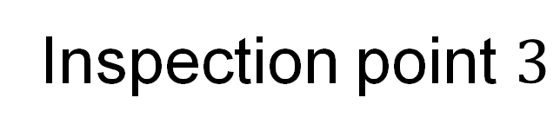
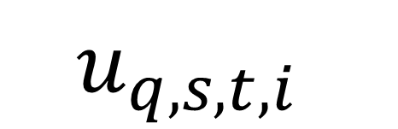
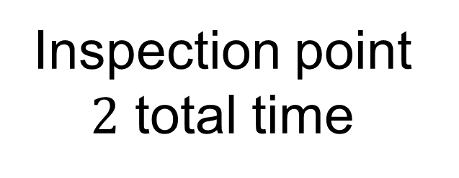
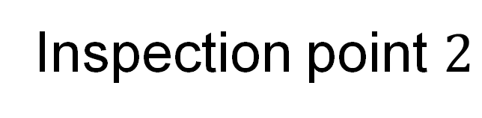
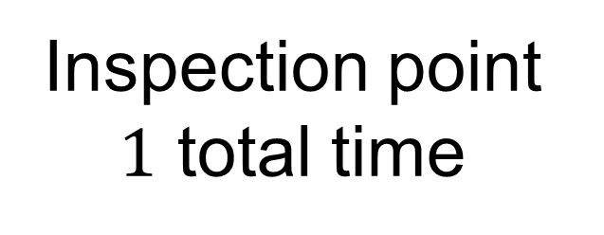
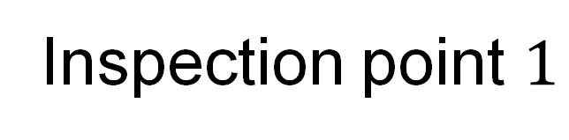
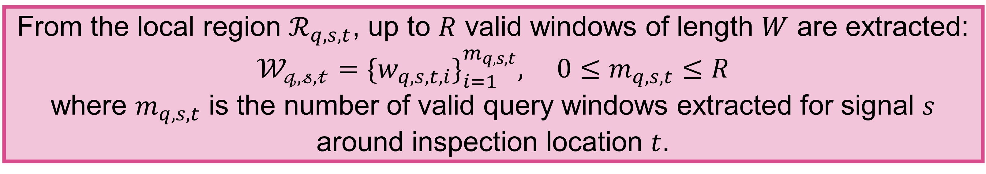
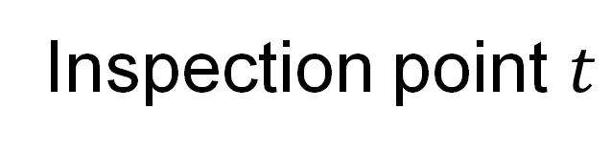
Model: Query Window Construction
Local signal-index region $ℛ_{q,s,t}⊆\{1,…,L_{q,s}\}$
Inspection point $1$
Inspection point $2$
…
Inspection point $3$
Inspection point $1$ total time
Inspection point $2$ total time
Inspection point $t$ total time
…
Inspection point $t$
…
From the local region $ℛ_{q,s,t}$, up to $R$ valid windows of length $W$ are extracted:
$$𝒲_{𝓆,𝓈,𝓉}=\{w_{q,s,t,i}\}_{i=1}^{m_{q,s,t}}, 0≤m_{q,s,t}≤R$$
where $m_{q,s,t}$ is the number of valid query windows extracted for signal $s$ around inspection location $t$.
Each query window is then embedded into the same latent space:
$$u_{q,s,t,i}$$
Latent Space

Slide 12
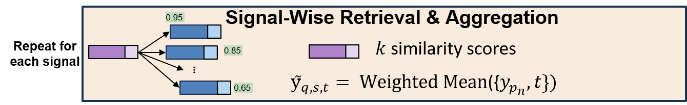
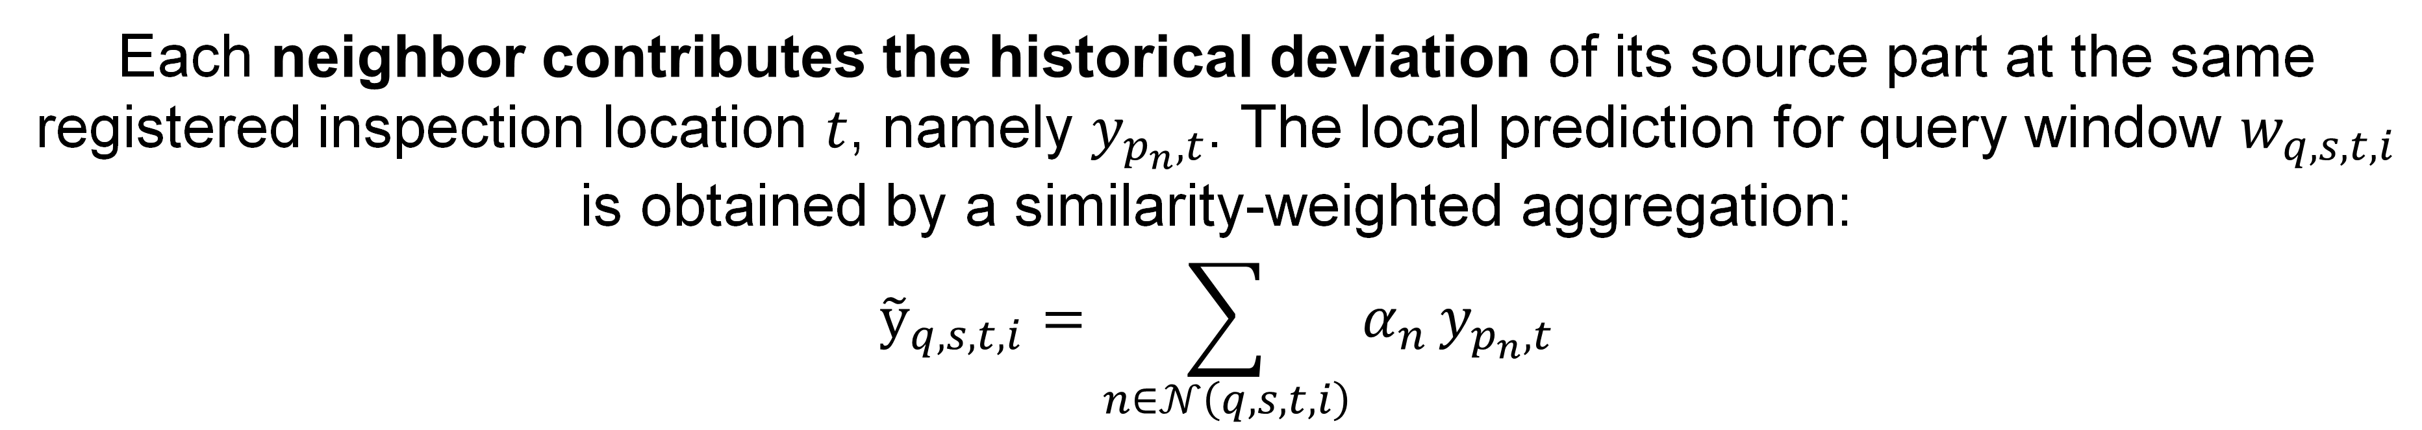
Model: Retrieval & Signal Fusion
For each query representation $u_{q,s,t,i}$, the method retrieves a non-empty set of nearest historical neighbors from $ℐ_{s}^{\left(−q\right)}$. Let $𝒩\left(q,s,t,i\right)⊆ℐ_{𝓈}^{\left(−𝓆\right)}$ denote this neighbor set.
Each neighbor contributes the historical deviation of its source part at the same registered inspection location $t$, namely $y_{p_{n},t}$. The local prediction for query window $w_{q,s,t,i}$ is obtained by a similarity-weighted aggregation:
$${\tilde{y}}_{q,s,t,i}=\sum_{n∈𝒩\left(q,s,t,i\right)}{α_{n}}y_{p_{n},t}$$

Slide 13
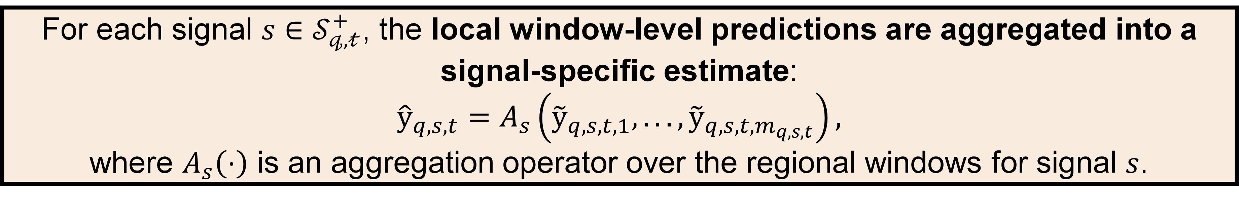
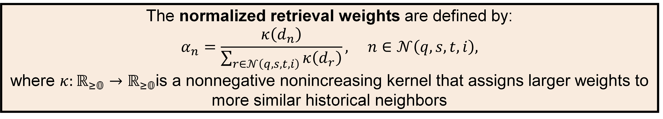

Model: Retrieval & Signal Fusion
The normalized retrieval weights are defined by:
$$α_{n}=\frac{κ\left(d_{n}\right)}{\sum_{r∈𝒩\left(q,s,t,i\right)}{κ\left(d_{r}\right)}}, n∈𝒩\left(q,s,t,i\right),$$
where $κ:ℝ_{≥𝟘}→ℝ_{≥𝟘}$is a nonnegative nonincreasing kernel that assigns larger weights to more similar historical neighbors
For each signal $s∈𝒮_{𝓆,𝓉}^{+}$, the local window-level predictions are aggregated into a signal-specific estimate:
$${\hat{y}}_{q,s,t}=A_{s}\left({\tilde{y}}_{q,s,t,1},..., {\tilde{y}}_{q,s,t,m_{q,s,t}}\right),$$
where $A_{s}\left(⋅\right)$ is an aggregation operator over the regional windows for signal $s$.
In the simplest case, $A_{s}$ is the arithmetic mean:
$${\hat{y}}_{q,s,t}=\frac{1}{m_{q,s,t}}\sum_{i=1}^{m_{q,s,t}}{{\tilde{y}}_{q,s,t,i}}, s∈𝒮_{q,t}^{+}.$$

Slide 14
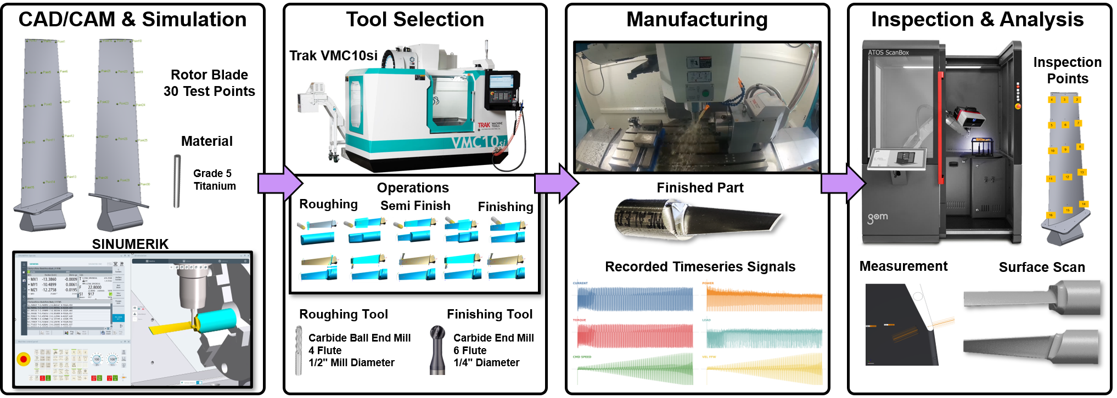
Experimental Design

Slide 15
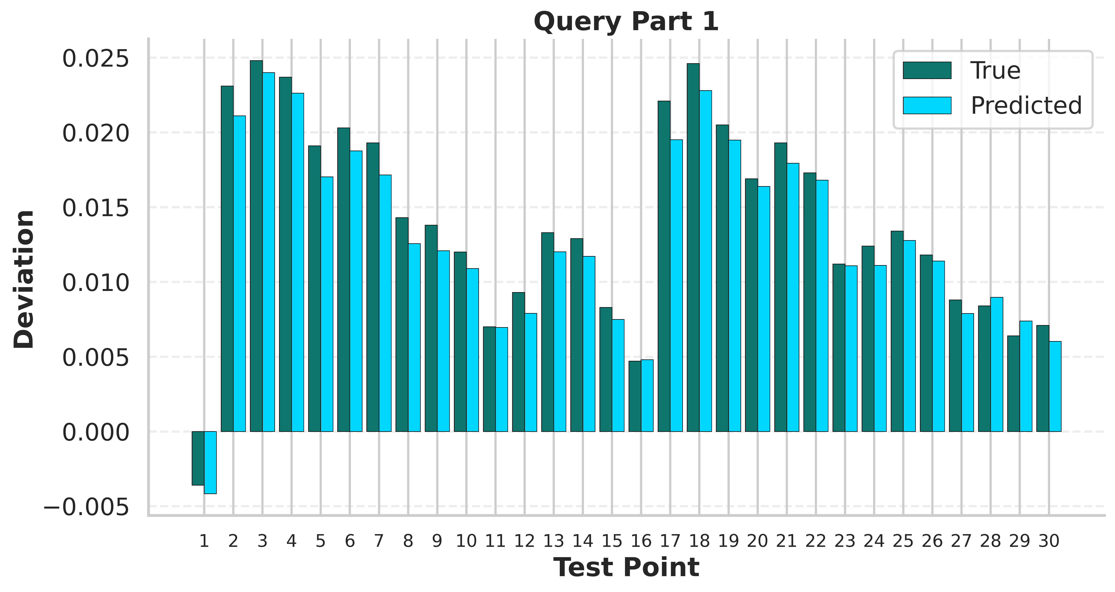
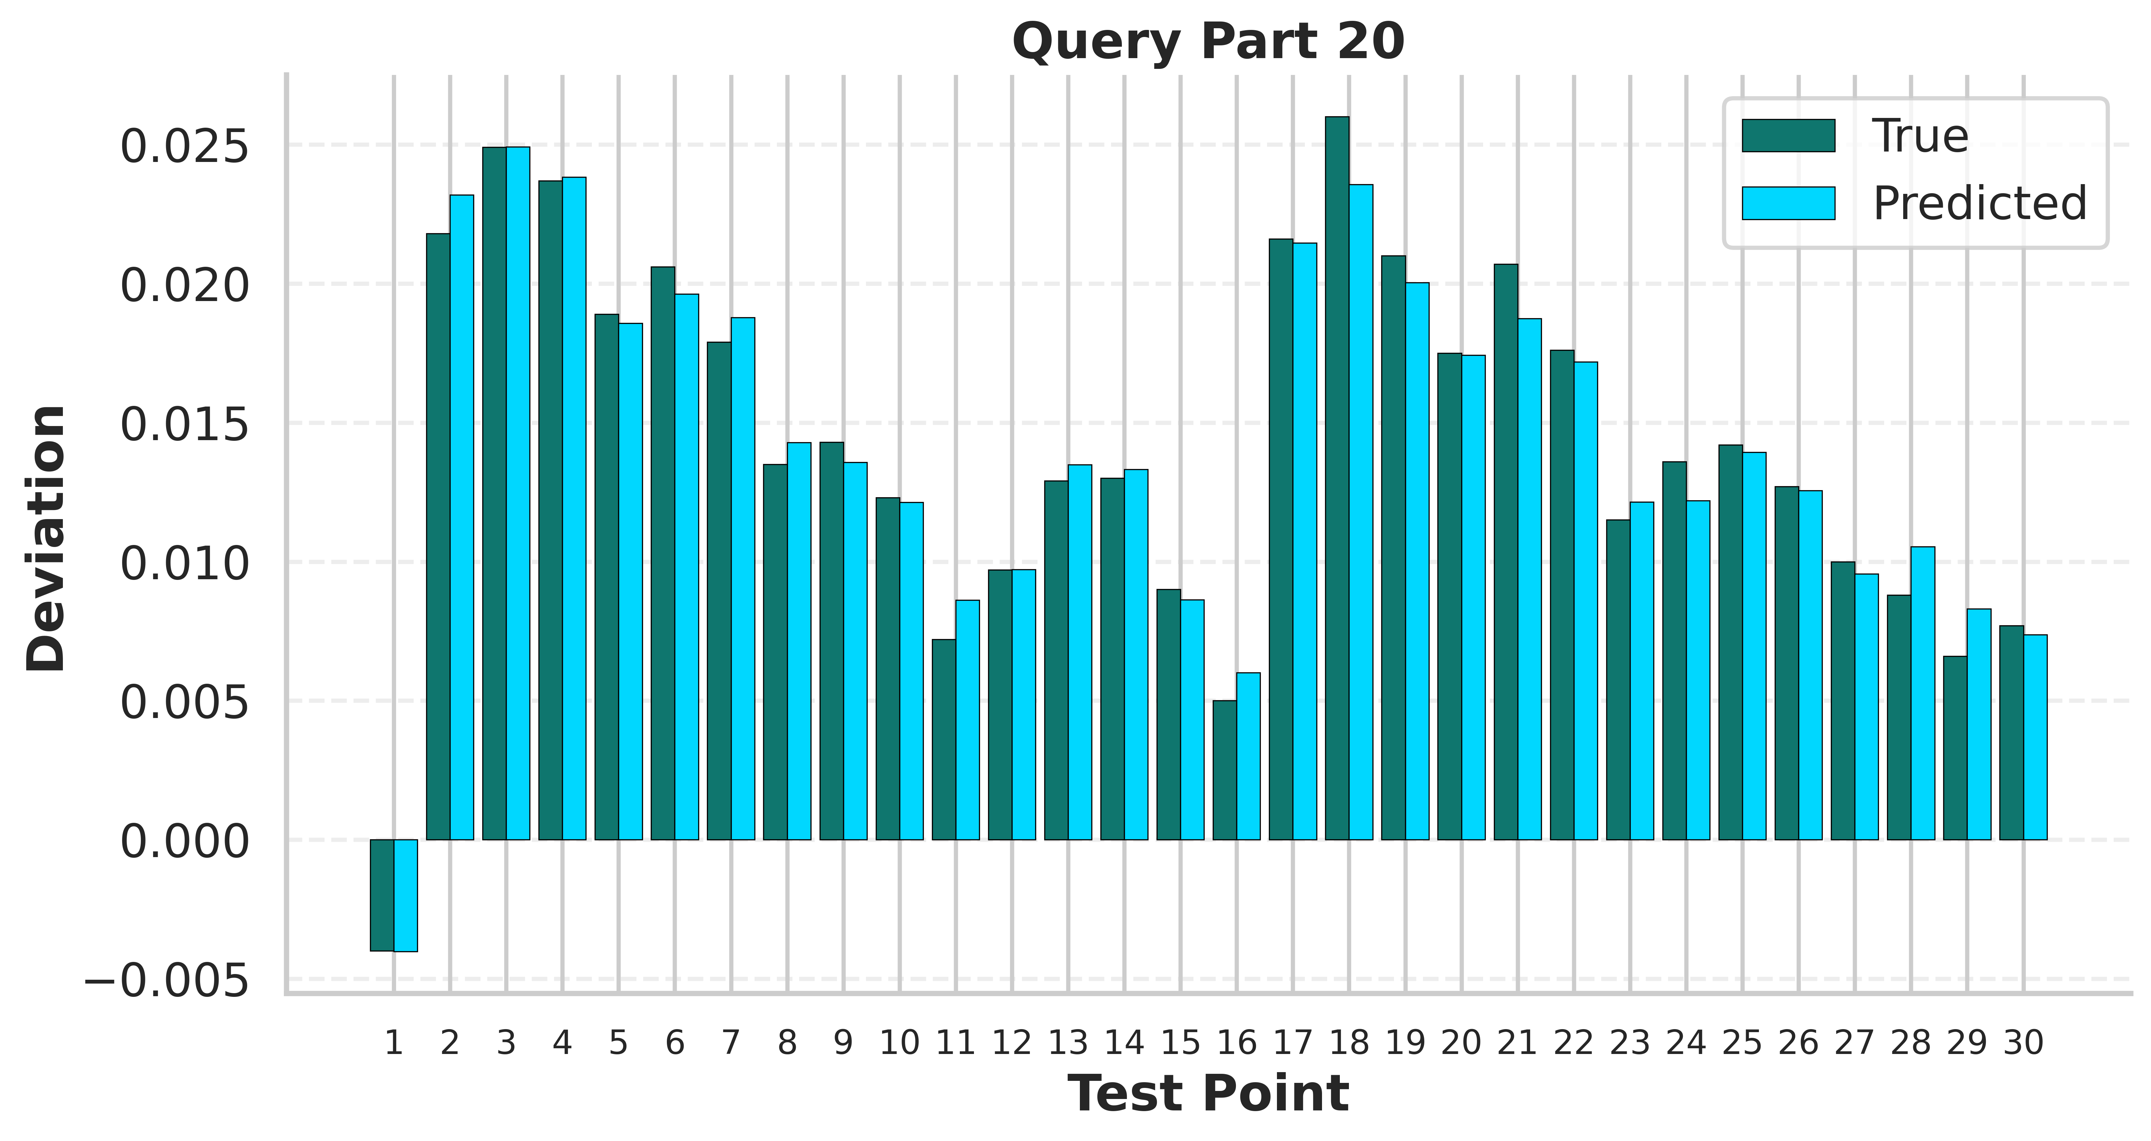
Results: Part Prediction
a)
ChronosGD captures the overall deviation profile across the blade, including the major peaks in the early and middle inspection regions and the gradual reduction in deviation toward later test points.
The predicted values generally follow the spatial trend of the measured deviations with relatively small local discrepancies.
b)

Slide 16
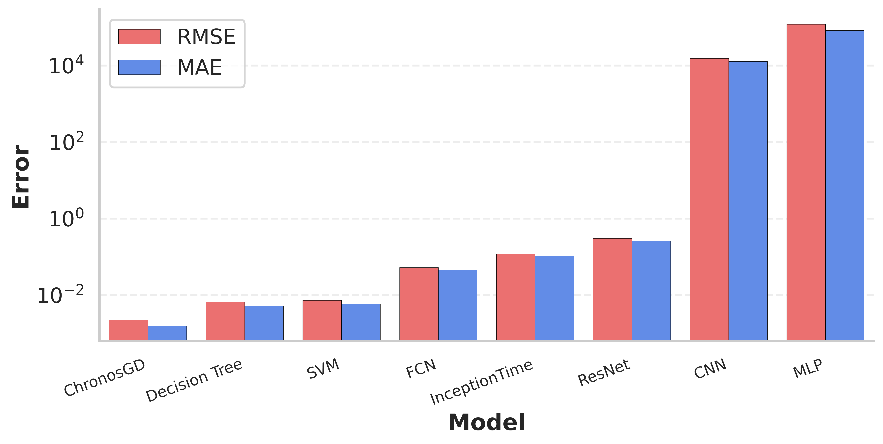
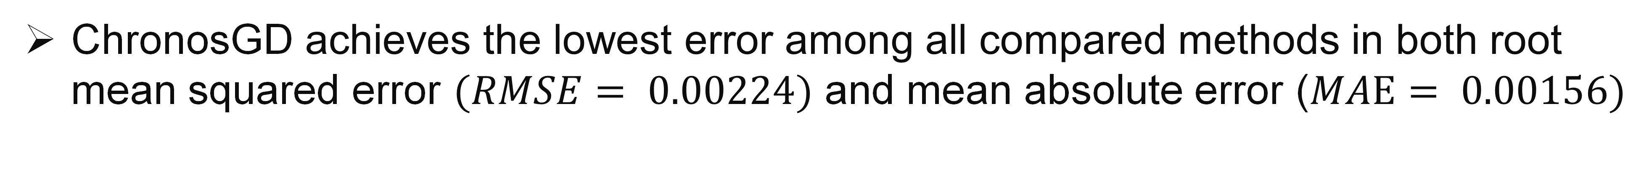
Results: Benchmark
ChronosGD achieves the lowest error among all compared methods in both root mean squared error $(RMSE= 0.00224)$ and mean absolute error ($MAE= 0.00156)$

Slide 17
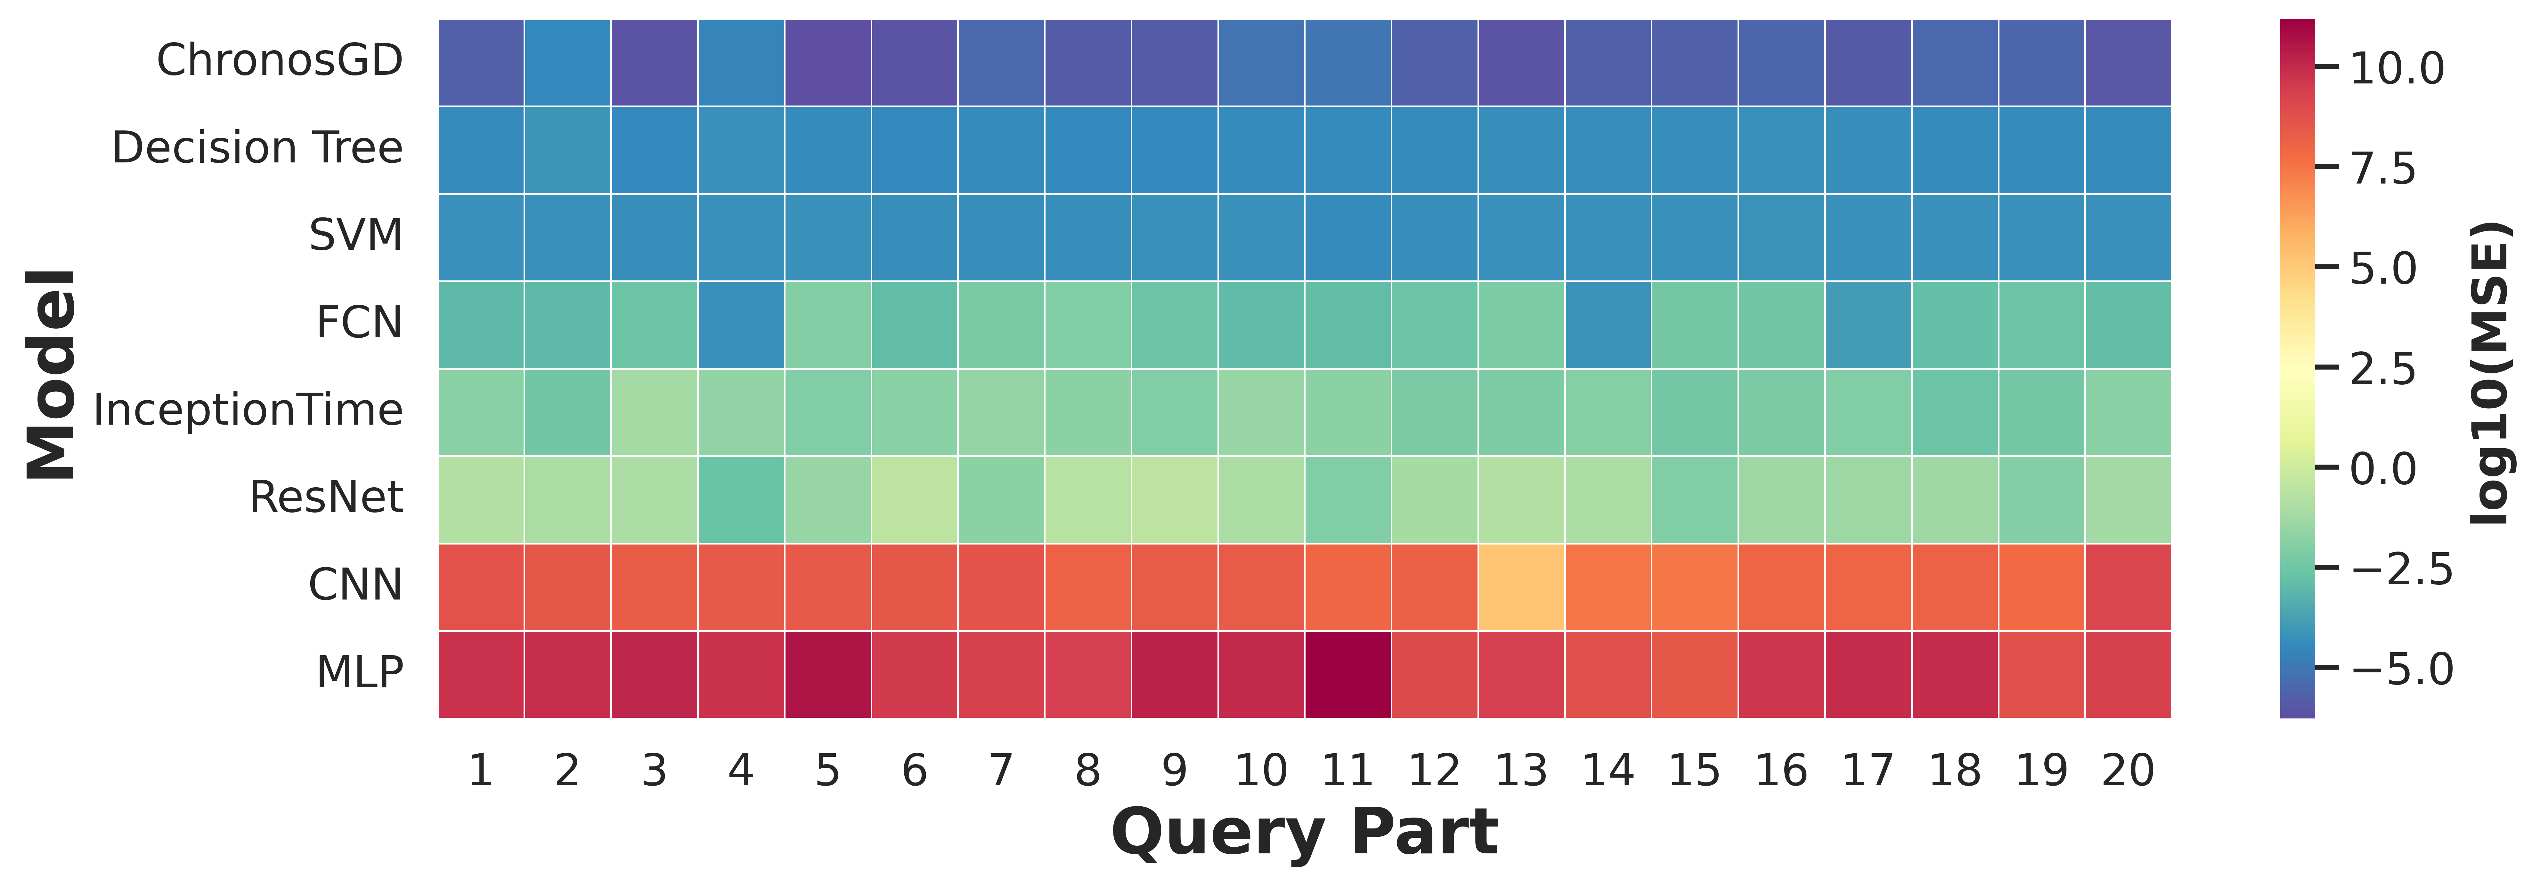

Results: Part-wise Benchmark
ChronosGD maintains low error across nearly all parts and exhibits the most favorable overall heatmap profile (mean -5.627, range [-6.270, -4.477]), and achieving the lowest MSE on all 20/20 query parts.$)$

Slide 18
Conclusion
ChonosGD was introduced as a retrieval-based framework for geometric deviation prediction from multichannel manufacturing signals using frozen Chronos-2 embeddings and historical similarity search.
ChronosGD accurately recovered part-wise deviation profiles and achieved lower prediction error and more consistent performance across unseen parts than the conventional regression and deep learning baselines.
ChronosGD is formulated as a deployment-level no-fine-tuning approach that replaces repeated task-specific retraining with memory refresh over historical process windows.
Future research will investigate real-time prediction during machining, including streaming inference from controller data, as well as edge deployment strategies that enable low-latency on-machine or near-machine decision support.

Slide 19




Acknowledgements
This work was supported under Cooperative Agreement W56HZV-21-2-0001 with the U.S. Army DEVCOM Ground Vehicle Systems Center (GVSC), through the Virtual Prototyping of Autonomy Enabled Ground Systems (VIPR-GS) program; the National Science Foundation (grant no. 2434519); and the Department of Energy (grant no. DE-EE0011029).
Disclaimer: Reference herein to any specific commercial company, product, process, or service by trade name, trademark, manufacturer, or otherwise, does not necessarily constitute or imply its endorsement, recommendation, or favoring by the United States Government or the Department of the Army (DoA). The opinions of the authors expressed herein do not necessarily state or reflect those of the United States Government or the DoA and shall not be used for advertising or product endorsement purposes.

